Slide 1


1801-1847
Chapter 15
IRELAND IN THE 1800S
ireland in the 1800s
Strand Two: The History of Ireland

Slide 2
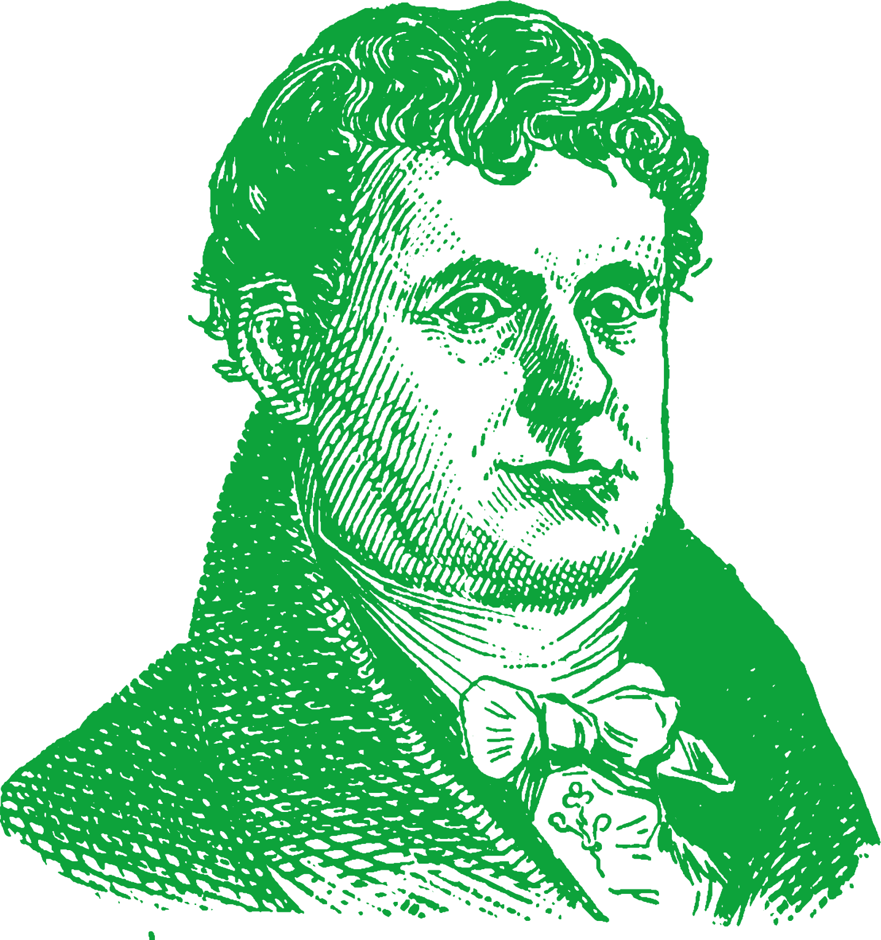
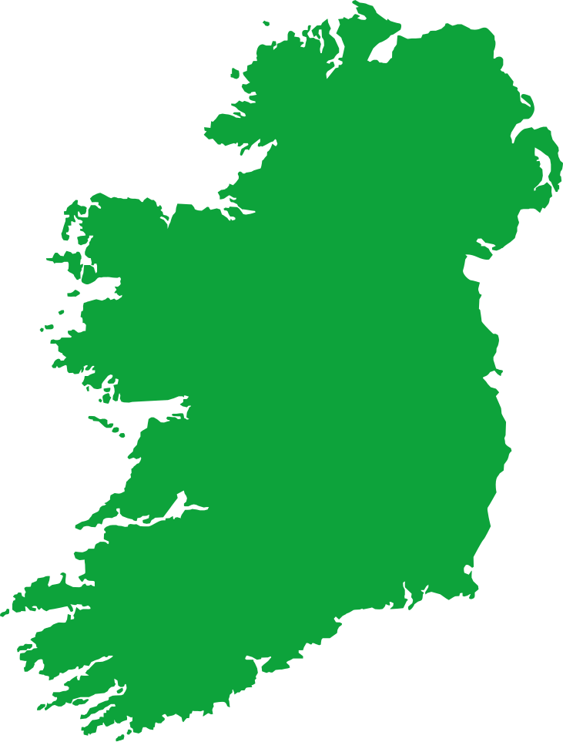
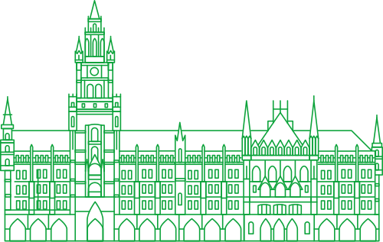
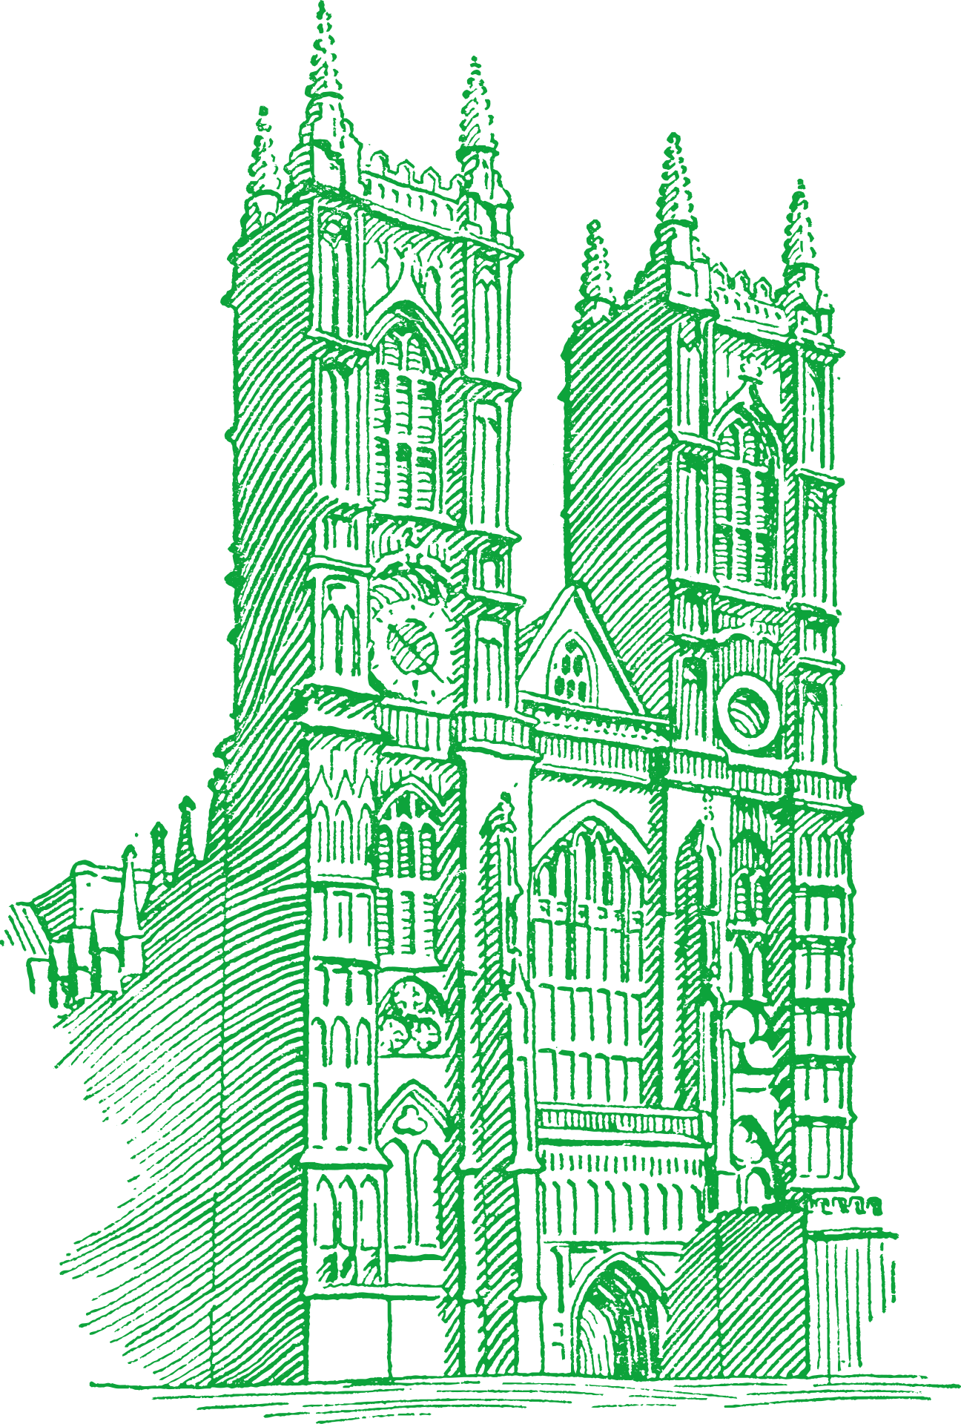








Chapter 15
IRELAND UNDER THE UNION
2.2 INVESTIGATE the role and significance of two leaders involved in the parliamentary tradition in Irish politics
Sir Robert Peel becomes home secretary while Daniel O'Connell is elected to Westminster
Repeal Campaign is led by Daniel O'Connell but failed.
The Great Famine begins in Ireland as the first blight causes the potato crop fails
1823
1828
1829
1840
1843
1845
1847
Strand Two: The Nature of History
Chapter Fifteen: Ireland under the Union
Roman Catholic Emancipation is led by Daniel O'Connell and is passed.
Clontarf Meeting is called off by O'Connell to prevent British forces killing his followers.
Daniel O’Connell dies in Italy and is returned to Ireland for burial in Glasnevin Cemetery
The Catholic Association is founded
@MsDoorley

Slide 3
Learning Outcomes
  2.2 INVESTIGATE the role and significance of two leaders involved in the parliamentary tradition in Irish politics
    First Leader – Daniel O’Connell
    Second Leader – Charles Stewart Parnell
  1.2 CONSIDER contentious or controversial issues in history from more than one perspective and DISCUSS the historical roots of a contentious or controversial issue or theme in the contemporary world
  1.3 APPRECIATE their cultural inheritance through recognising historically significant places and buildings and discussing why historical personalities, events and issues are commemorated
Chapter Fifteen: Ireland under the Union
Strand Two: The History of Ireland
@MsDoorley

Slide 4
Introduction
After the 1800 Act of Union, Britain and Ireland were united under one government in Westminster for the first time. The two islands were very different, however. Ireland was primarily an agricultural economy with many small farmers, most of whom were tenants of landlords. Britain, on the other hand, was a rapidly industrialising country as the Industrial Revolution began, introducing faster means of production and transport. In response to the Act of Union, Irish nationalists fought campaigns seeking full equality for Catholics and the restoration of an Irish parliament. In the early half of the 19th century bore witness to Daniel O'Connell, the Liberator.
Chapter Fifteen: Ireland under the Union
Strand Two: The History of Ireland
@MsDoorley

Slide 5
1801-1847
Chapter 15
15.1: LIFE IN IRELAND IN THE 1800S
15.1: life in ireland in the 1800s
Strand Two: The History of Ireland
@MsDoorley

Slide 6
Ireland after the Act of Union
From 1801 to 1841, the population of the island had reached 8.2 million, up from 5.5 million.
While some parts of Ireland were industrialised such as Belfast and Dublin but not to the same extent as Britain. Ireland did not have coal (to power factories) or iron resources and did not use steam engines to the extent that Britain did. Nonetheless, Ireland did have railways and canals for the transportation of people and goods. Ulster had a successful textiles industries particularly linen. Irish lace and linen was considered the best in the world as well as a flourishing, rising shipbuilding industry. Dublin's industry was primarily wool and Guinness. Most of rural Ireland's exports to Britain went through Dublin port.
Chapter Fifteen: Ireland under the Union
Strand Two: The History of Ireland
@MsDoorley

Slide 7
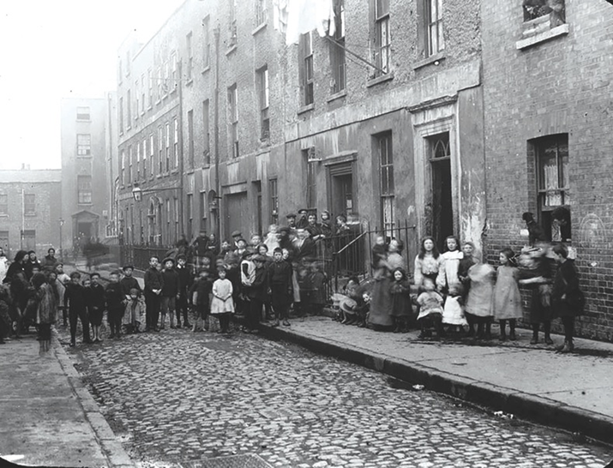
Life in Belfast and Dublin
Life was difficult for the poorest people in Dublin, Belfast and other Irish cities.
  Overcrowding became a serious problem, with many tentaments being built that were unsanitary while also leading to one, sometimes two families living in just one room.
  Diseases such as typhoid, cholera, smallpox, scarlet fever and tuberculosis were common. Infant death rates were also high.
  Adults and children both worked in factories and on the docks to make enough money to support their families. It was common to work from 5.30 am until 8pm, six days a week, with only Sundays off.
  Employment was casual, competition was high for jobs so it meant low wages.
  Fighting and drinking were popular past-times leading to a high crime.
Chapter Fifteen: Ireland under the Union
Strand Two: The History of Ireland
Diagram taken from Artefact, 2nd Edition by Eimear Jenkinson and Gregg O'Neill (educate.ie)
@MsDoorley

Slide 8
Life in rural Ireland in the 1800s
In 1841, over 70% of Ireland’s population was still living in the countryside on farms whereas the majority of Britain's population lived in towns and cities. Ireland's population had doubled in under a century. Reasons for this increase included:
  The Irish tended to marry young and have large families.
  Enclosure, improvements to farming, and new machinery produced more food than before.
Ireland exported livestock, such as cattle, and grain to Britain. There was no real effort to industrialise Ireland the way Britain was industrialised at the time. It was claimed that Britain would work better if Ireland produced the food to feed both islands and Britain did the same with industrialised goods.
Most land was owned by landowners who were descendants of the planters. The Irish rented and farmed this land. Irish people rented and farmed this land, growing crops to feed to feed their families and pay their rent. Most farmers in Ireland were tenant farmers. There were two types:
  Large farmers were farmers who rented more than 30 acres. They were able to hire help to work the land. Their diet consisted of meat, milk, potatoes and vegetables.
  Small famers were farmers who rented between five and 30 acres. They subdivided their land amongst all their sons. Their diet consisted of potatoes and milk.
Poorer people worked as labourers. Cottiers were labourers who rented one acre from a farmer. They usually paid their rent by working for the farmer. They had a one-room thatched cottage and grew potatoes. In 1845, there were one million Irish cottiers – including their families, that made up 4 million people; HALF THE POPULATION!
Chapter Fifteen: Ireland under the Union
Strand Two: The History of Ireland
Diagram taken from Artefact, 2nd Edition by Eimear Jenkinson and Gregg O'Neill (educate.ie)
@MsDoorley

Slide 9
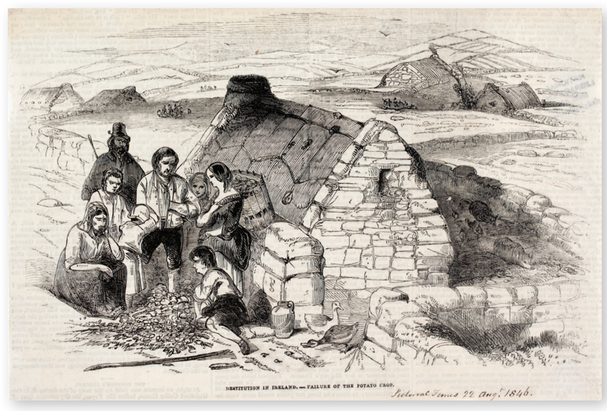
Chapter Fifteen: Ireland under the Union
Strand Two: The History of Ireland
Diagram taken from Artefact, 2nd Edition by Eimear Jenkinson and Gregg O'Neill (educate.ie)
@MsDoorley

Slide 10
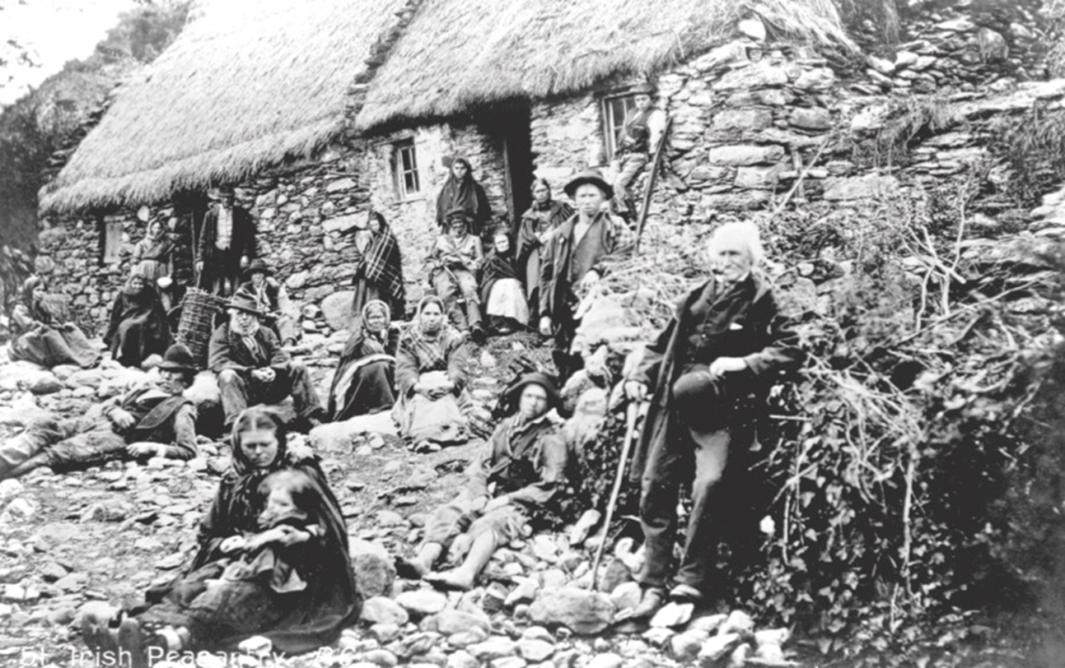
Chapter Fifteen: Ireland under the Union
Strand Two: The History of Ireland
Diagram taken from Artefact, 2nd Edition by Eimear Jenkinson and Gregg O'Neill (educate.ie)
@MsDoorley

Slide 11
Checkpoint pg. 169 (Artefact, 2nd Edition)
  By how much did Ireland’s population grow between 1801 and 1841?
  How were Belfast and Dublin different from the rest of the island?
  Name two examples of industries that were strong in Ireland in the 1800s.
  How did this overcrowding affect people’s lives? What problems did they face?
  Give two reasons why Ireland's population doubled in under a century.
  What was the difference between a large farmer and a small farmer?
  What was a cottier?
Chapter Fifteen: Ireland under the Union
Strand Two: The Nature of History
@MsDoorley

Slide 12
Checkpoint pg. 169 (Artefact, 2nd Edition)
1. Ireland’s population grew from 5.5 million to 8.2 million = an increase of 2.7 million.
2. Belfast and Dublin differed from the rest of the island because they had some industry.
3. Any two of: linen, lace or shipbuilding around Belfast; wool, weaving or Guinness’s brewery in Dublin.
4. Some of Ireland’s rapidly rising population had migrated to the cities to seek work. People lived in large tenement buildings in the centres, sometimes two families to a room. Conditions were unsanitary; sewage sometimes overflowed into water sources; disease spread easily; people worked hard for long hours, for low pay, with no job security; drinking, gambling and fighting were common and the crime rate was high.
5. The Irish tended to marry young and have large families. Enclosure and other improvements to farming methods arrived in Ireland, as in Britain, and the new machinery produced more food than before.
6. A large farmer rented more than 30 acres, whereas a small farmer rented between five and 30 acres.
7. Cottier: a labourer who rented one acre from a farmer.
Chapter Fifteen: Ireland under the Union
Strand Two: The Nature of History
@MsDoorley

Slide 13
1801-1847
Chapter 15
15.1: LIFE IN IRELAND IN THE 1800S
15.2: politics in 1800s ireland
Strand Two: The History of Ireland
@MsDoorley

Slide 14





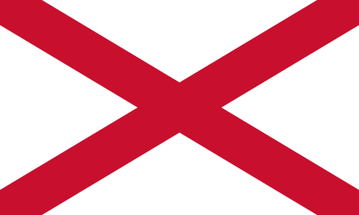

The government of Ireland
The Act of Union (1801) removed the Irish Parliament from Dublin. 100 Irish MPs would now sit in the House of Commons in Westminster while 32 Lords would sit in the House of Lords. Laws passed in London applied to the islands of Great Britain and Ireland.
The government of Ireland was based in Dublin Castle. The head of the Irish government was the Chief Secretary who spent most of his time in London. The British monarchy (King or Queen) was represented by the Lord Lieutenant.
England
Scotland
Chapter Fifteen: Ireland under the Union
Strand Two: The History of Ireland
Original Union Flag (1606)
Ireland
Current Union Jack (1801)
Diagram taken from Artefact, 2nd Edition by Eimear Jenkinson and Gregg O'Neill (educate.ie)
@MsDoorley

Slide 15
'The Catholic Question'
The biggest political issue in Ireland at the time was the Catholic Question. Catholics supported the Act of Union as the British government promised to abolish the last of Penal Laws and Catholic emancipation. However as all MPs had to swear an oath recognising the King of England as the head of Church, no Catholic could become an MP as they could not swear this oath (Pope is the head of the Church). Catholics also resented paying tithes to the Church of Ireland. With the rise of the Catholic middle class, Daniel O’Connell became the champion for the campaign of Catholic Emancipation.
Chapter Fifteen: Ireland under the Union
Strand Two: The History of Ireland
Diagram taken from Artefact, 2nd Edition by Eimear Jenkinson and Gregg O'Neill (educate.ie)
@MsDoorley

Slide 16
Checkpoint pg. 170 (Artefact, 2nd Edition)
  How many Irish MPs represented Ireland in Westminster?
  What was Catholic emancipation?
  Why were Catholics unhappy in Ireland after the Act of Union?
Chapter Fifteen: Ireland under the Union
Strand Two: The Nature of History
@MsDoorley

Slide 17
1801-1847
Chapter 15
15.3: DANIEL O'CONNELL, 'THE LIBERATOR', 1775-1847
15.3: Daniel O'Connell, 'The Liberator', 1775-1847
Parliamentary tradition is the use of peaceful political means to achieve political change. For example, in attempts to achieve Irish independence, the Home Rule Bill and the Repeal Campaign belong to parliamentary tradition while the 1798 Rebellion and the 1916 Easter Rising belong to physical force tradition.
Strand Two: The History of Ireland
@MsDoorley

Slide 18
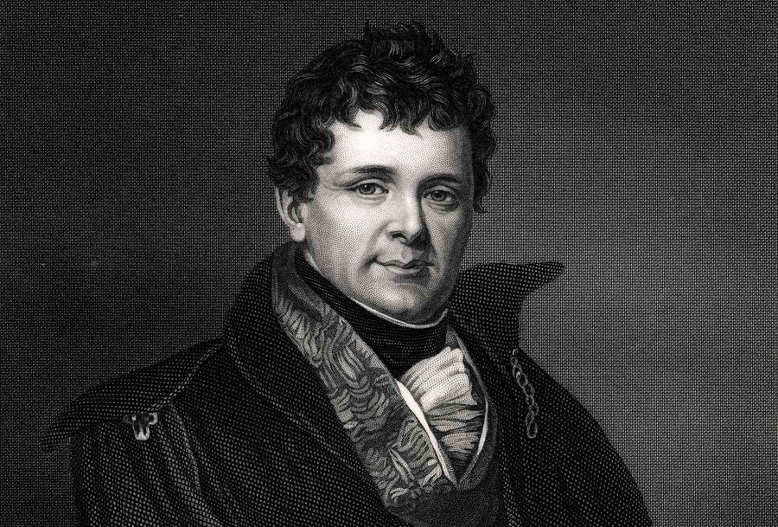
Early Life
Daniel O’Connell was born in 1775 in Cahirciveen, Co. Kerry. He was born into a wealthy, Catholic middle-class family. He grew up among the tenant farmers of his uncle's lands and learned both Irish and English. Like most well-off Catholic families, he was sent to France to get a university education as Catholics were not permitted to attend Trinity College Dublin. His time in Paris overlapped with the reign of Terror in the French Revolution, when thousands of people were executed for supposedly being enemies of the revolution. O’Connell returned to Ireland with a hatred of political violence. He supported the aims of the United Irishmen in the 1798 Rebellion but rejected their use of violence.
Strand Two: The History of Ireland
Chapter Eleven: The Irish Plantations
Diagram taken from Artefact, 2nd Edition by Eimear Jenkinson and Gregg O'Neill (educate.ie)
@MsDoorley

Slide 19
Catholic Emancipation
O’Connell became a barrister (lawyer). In 1811, he founded the Catholic Board to campaign for Catholic Emancipation with limited results. 1823 saw him founding the Catholic Association which campaigned for: end of tithe payments, rights for tenant farmers and Catholic Emancipation. It was a mass membership organisation. The membership fee - Catholic Rent (one penny a month, collected at church gates) - was low enough to be affordable to all but the poorest. This money funded the Campaign, supported pro-emancipation MPs, paid the legal costs of those arrested for campaigning and paid for publicity material.
In 1828, O’Connell stood in Co. Clare for election to Westminster. He won the seat but refused to take the parliamentary oath and was unable to take his seat. The British Prime Minister, the Duke of Wellington (only British PM to have been born in Ireland) feared another rebellion. Westminster passed the Emancipation Act in 1829, allowing O’Connell took his seat. It was O’Connell’s greatest achievement and led to him being known as the Liberator. King George IV referred to him as the King of Ireland, such was O'Connell's popularity and power after emancipation.
Strand Two: The History of Ireland
Chapter Eleven: The Irish Plantations
@MsDoorley

Slide 20
The fight for repeal
During the 1830s, O’Connell campaigned inside and outside Westminster for the abolition of tithe payments.
In 1838, he managed to get them lowered and paid to landlords instead of the Church of Ireland. He was elected the first Lord Mayor of Dublin.
In 1930, the Repeal Association to campaign for the abolition of the Act of Union and the restoration of the Irish Parliament, while the British monarch remaining as king or queen of Ireland. He used his previous tactics: people a Repeat Rent to support the campaign.
There was little support for repeal in Britain and at the end of the 1830s, O'Connell started organising monster meetings all over Ireland with over 100,000 people attending. The British government grew concerned that these meetings would lead to rebellion and banned one such meeting at Clontarf was banned in 1843. Many of O'Connell's called off the meeting. This led to a split in the movement, with younger members setting up the Young Irelanders, who wanted an all-Ireland struggle for independence and democratic reform.
Strand Two: The History of Ireland
Chapter Eleven: The Irish Plantations
@MsDoorley

Slide 21
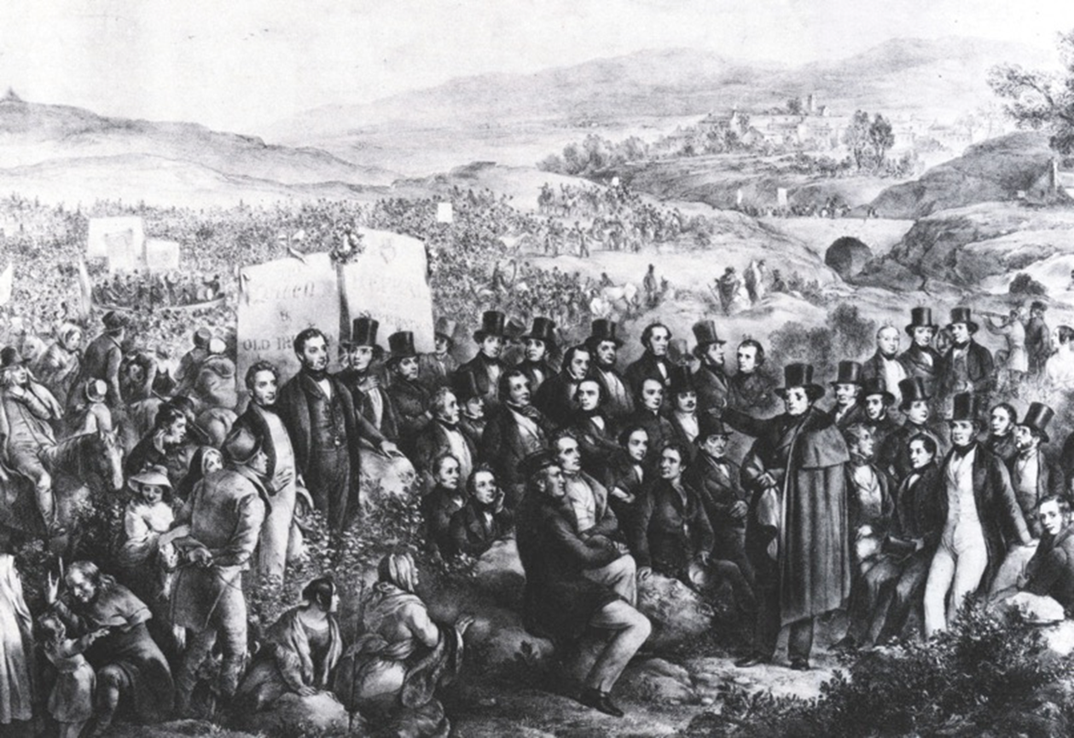
Chapter Fifteen: Ireland under the Union
Strand Two: The History of Ireland
Diagram taken from Artefact, 2nd Edition by Eimear Jenkinson and Gregg O'Neill (educate.ie)
@MsDoorley

Slide 22
Death and legacy
Just as the Great Famine began in 1845, O’Connell’s health began to fail. His last speech in the House of Commons in February 1847 was an impassioned plea for help for the Irish people dying of starvation. He died on a pilgrimage to Rome in May 1847.
O’Connell’s approach to political action – rejecting the use of force and relying on mass organisation of people – influenced people like Mahatma Gandhi and Martin Luther King during the 20th Century. He was also an inspiration to the American campaigner for the abolition of slavery in the USA, Frederick Douglas, who said of O'Connell; "I have heard many speakers within the last four years - speakers of the first order; but I confess, I have never heard one by whom I was more completely captivated than by Mr O'Connell."
In Ireland, the rejection of violence was also presented in politics like people like Charles Stewart Parnell, John Redmond and John Hume. William Gladstone, British Prime Minister in 1870s and 1880s, described O’Connell as “the greatest popular leader the world has ever seen”.
Strand Two: The History of Ireland
Chapter Eleven: The Irish Plantations
@MsDoorley

Slide 23
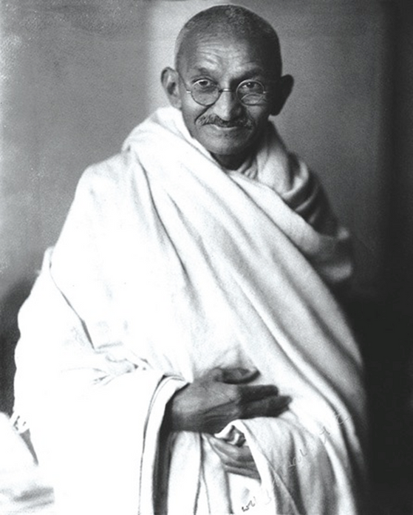
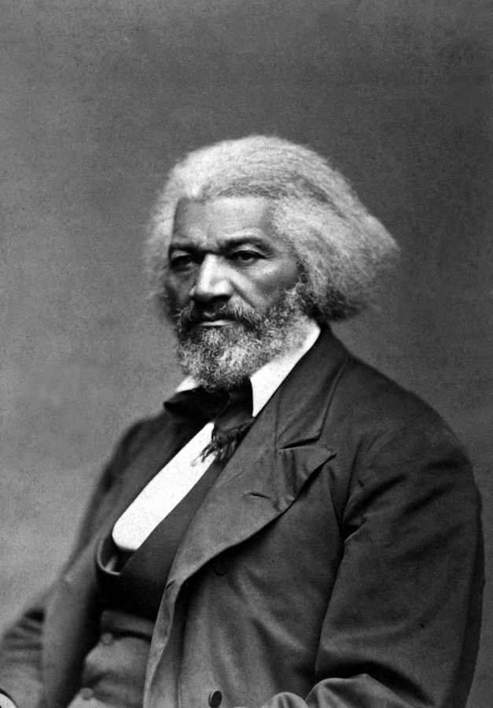
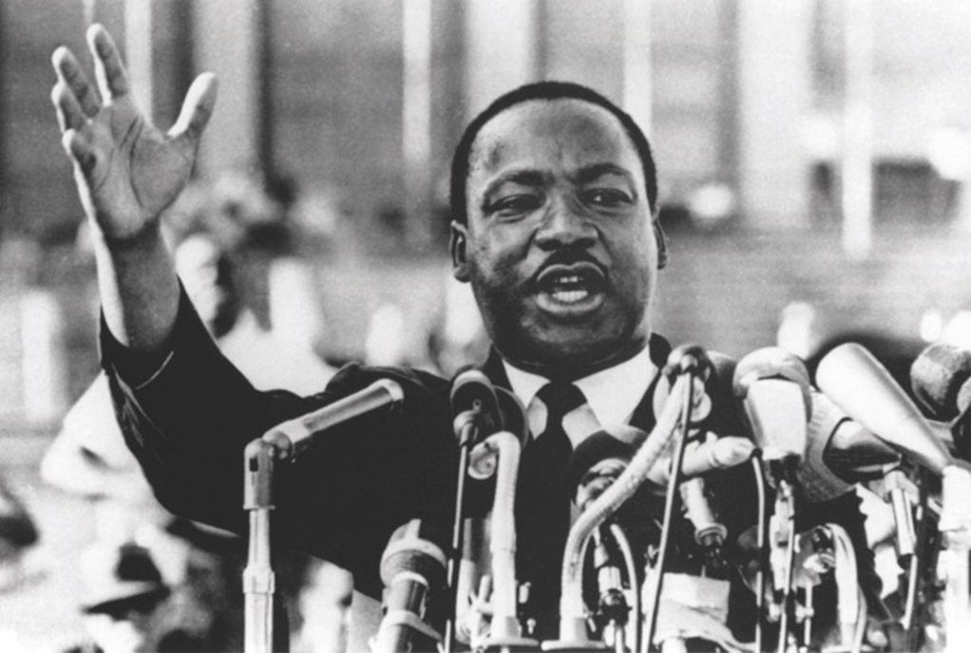
Mahatma Gandhi
Frederick Douglas
Chapter Fifteen: Ireland under the Union
Strand Two: The History of Ireland
Martin Luther King Jr
Diagram taken from Artefact, 2nd Edition by Eimear Jenkinson and Gregg O'Neill (educate.ie)
@MsDoorley

Slide 24
Checkpoint pg. 173 (Artefact, 2nd Edition)
  How did the French Revolution influence O’Connell?
  How did the Catholic Association campaign for emancipation?
  What happened in 1828?
  How did the British government respond to O’Connell’s election? Why did they do this?
  What were monster meetings? Why was the British government afraid of them?
  How did O’Connell respond to the banning of the Clontarf meeting? What impact did this have on the Repeal movement?
  What was O’Connell’s legacy and impact on (a) Ireland; and (b) the rest of the world?
Chapter Fifteen: Ireland under the Union
Strand Two: The Nature of History
@MsDoorley

Slide 25
1801-1847
Chapter 15
15.4: SUMMARY
15.4: summary
Strand Two: The History of Ireland
@MsDoorley

Slide 26
In this chapter, we have learned that...
  Limited industrialisation took place around Dublin and Belfast. Most of the country remained rural and most farmers were small landholders who rented from landlords.
  Factories brought thousands of people to work in the cities, where they lived in cramped and dirty conditions. They worked long hours for low pay and were suspectible to many diseases because of poor sanitation and diet.
  Catholics were excluded from sitting in parliament. Daniel O’Connell led the successful campaign for Catholic Emancipation in 1828, using mass protests and peaceful campaigning.
  However, he failed to achieve the repeal of the Union in the 1840s.
Chapter Fifteen: Ireland under the Union
Strand Two: The History of Ireland
@MsDoorley

Slide 27
Reflecting on... Ireland in the 1800s
It is difficult not to see O'Connell's failure to achieve repeal of the Union as a missed opportunity in Irish history. His commitment to peaceful means was in start contrast to those who went before him in the United Irishmen and those who came after him in the various Irish Republican movements. The failure of non-violent mass protest convinced many of the next generation that the only solution to Ireland's problems lay with the gun.
Chapter Fifteen: Ireland under the Union
Strand Two: The History of Ireland
@MsDoorley

Slide 28
SEC Examination Questions
Chapter Fifteen: Ireland under the Union
Strand Two: The History of Ireland
@MsDoorley

Slide 29
Project
Guidelines:
  Length: The depth of your project should reflect about 2-3 weeks of work.
  Sources: Use at least three different sources for your research. These can be books, scholarly articles, or reputable online resources.
  Citations: All information and images that are not your own should be properly cited.
  Mediums: You may choose to present your project in one of the following ways:
    Poster: Your poster should be informative and visually engaging.
    Minecraft or Lego Model: If choosing this option, please also include a brief report explaining your model.
    Painting/Drawing: Your artwork should be accompanied by a description.
    Recycled Materials: Create your model using recycled materials and provide an explanation of your creative process.
Assessment:
Your projects will be assessed based on:
  Research and Content
  Creativity and Presentation
  Understanding of Context
  Adherence to Guidelines
Strand Two: The History of Ireland
Chapter Fifteen: Ireland under the Union
@MsDoorley

Slide 30
Project
Historical Sites
Historical Figures
O'Connell Monument, Dublin, Republic of Ireland
Derrynane House, Caherdaniel, County Kerry
Emancipation Stone, Dunmanway, County Cork
Clongowes Wood College Chapel, Clane, County Kildare
Palace of Westminster, London, England
Daniel O'Connell
Henry Grattan
Robert Peel
Arthur Wellesley, 1st Duke of Wellington
John Keogh
Richard Lalor Sheil
Sir Francis Burdett
Bishop James Doyle
William Cobbett
Edward Cooke
Strand Two: The History of Ireland
Chapter Fifteen: Ireland under the Union
@MsDoorley

